Slide 1

SyncVR Data Analyst Internship Assignment
By: Cameron Abernethy

Slide 2

The Data
Kaggle Dataset
Source - https://www.kaggle.com/datasets/itachi9604/disease-symptom-description-dataset?resource=download
Focus: Predicting diseases based upon symptoms presented by a patient
Original Contents -
131 unique symptoms
40 unique diseases
4920 rows
Up to 17 reported symptoms

Slide 3
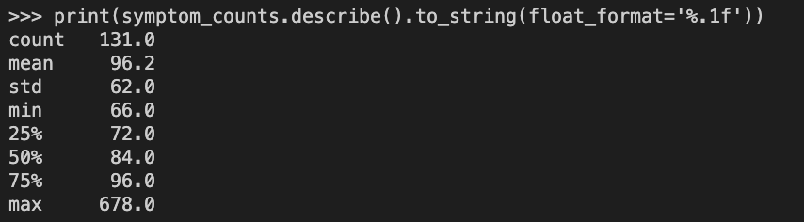
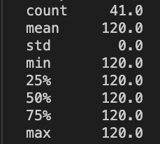
Summary Statistics
Symptoms:
Diseases:

Slide 4
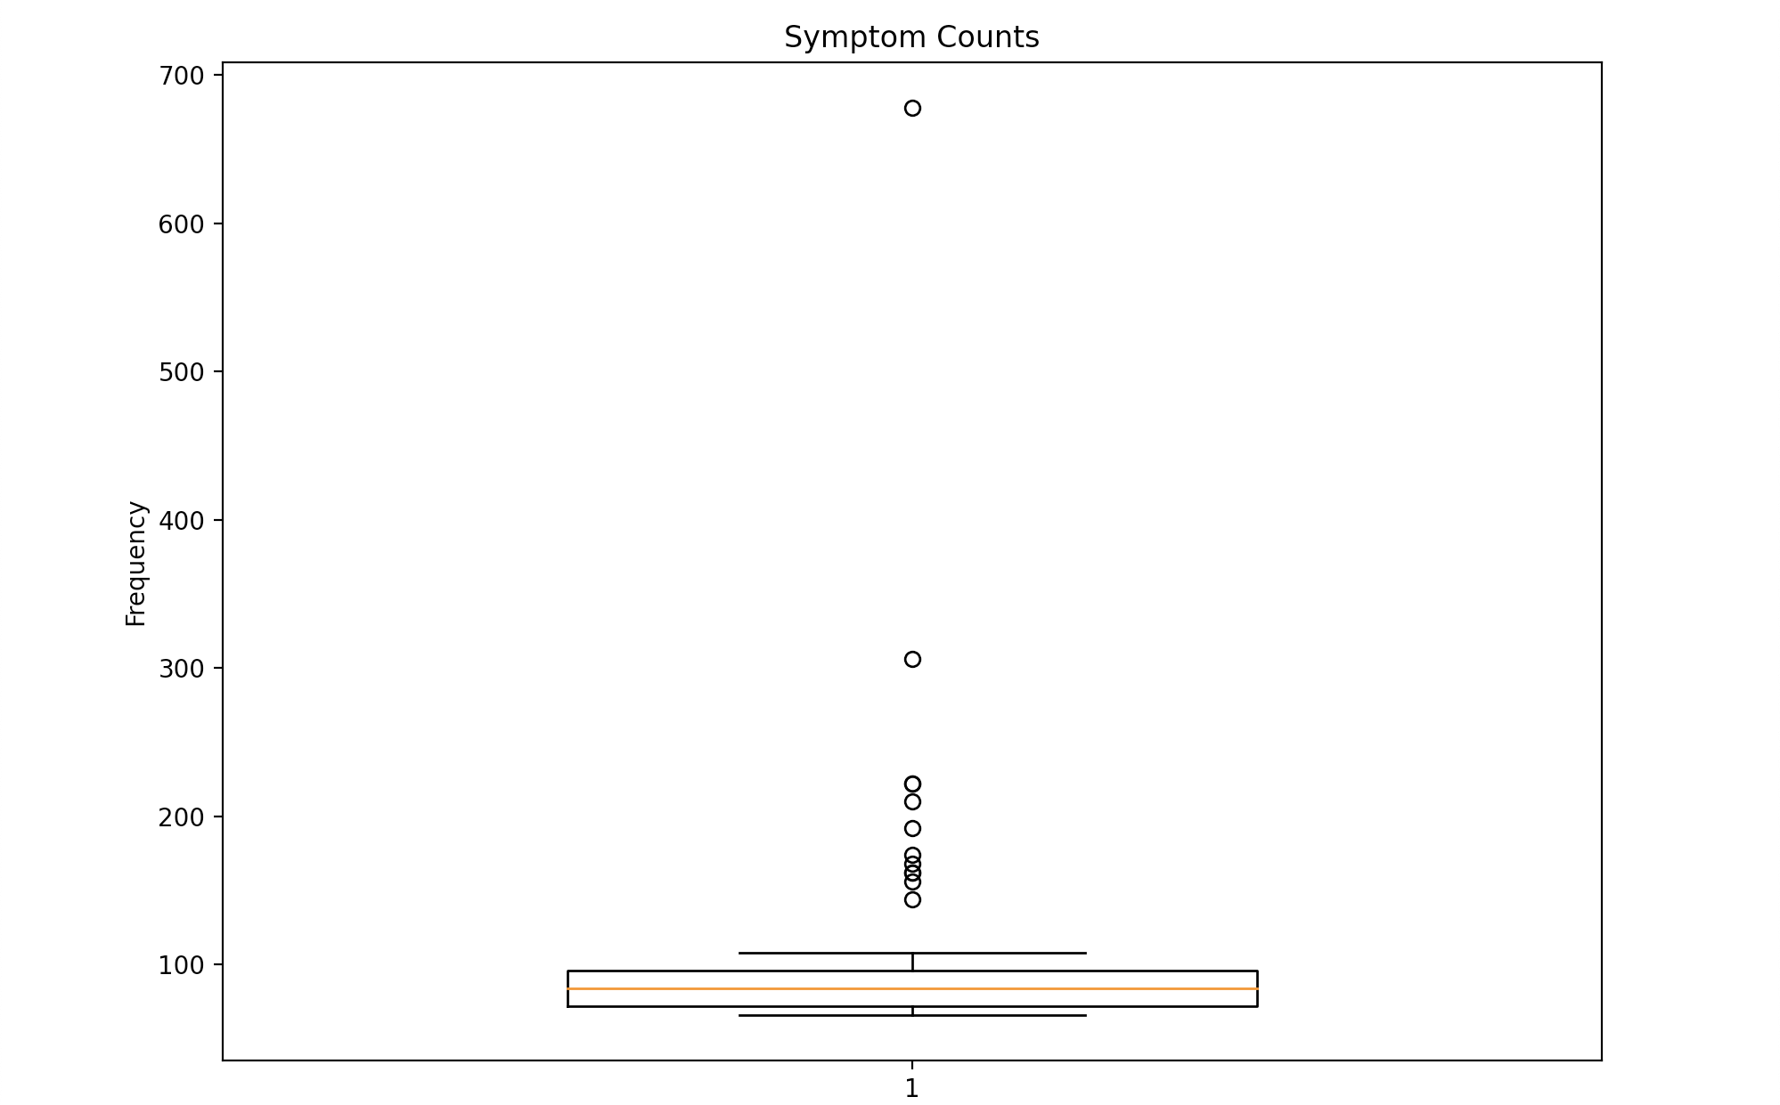
Symptoms Summary
Most Common Symptom(s): Itching (678 Occurrences)
Least Common Symptom(s): Visual Disturbances, Red Spots Over Body, Spotting Urination (66 Occurrences)

Slide 5
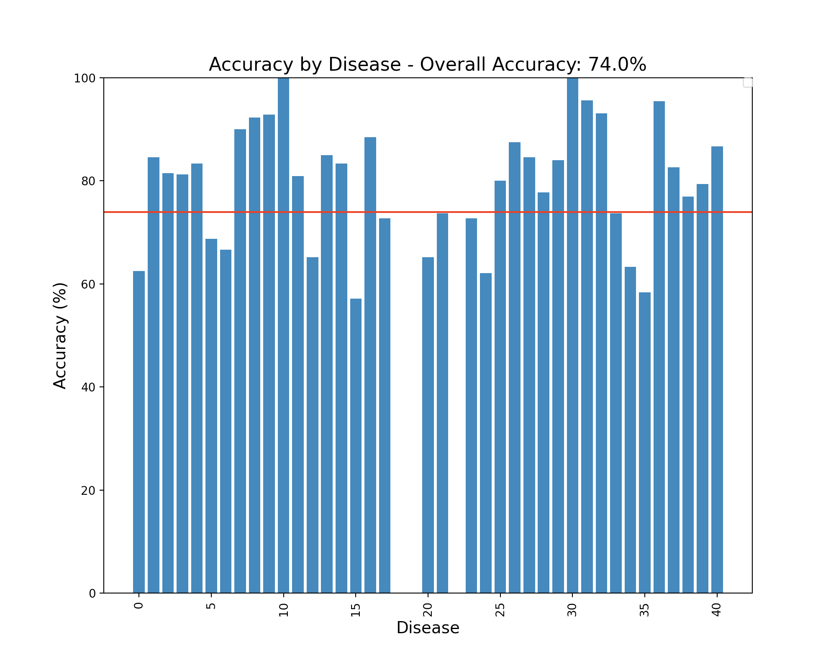

KNN Model Results
Number to Disease Dictionary:
{0: 'hepatitis a',
1: 'malaria',
2: 'peptic ulcer diseae',
3: 'diabetes',
4: 'typhoid',
5: 'pneumonia',
6: 'heart attack',
7: 'gastroenteritis',
8: 'fungal infection',
9: 'jaundice',
10: 'cervical spondylosis',
11: 'gerd',
12: 'migraine',
13: 'acne',
14: 'hypertension',
15: 'hypoglycemia',
16: 'impetigo',
17: 'drug reaction',
18: 'hepatitis b',
19: 'dimorphic hemmorhoids(piles)',
20: 'chicken pox',
21: 'paralysis (brain hemorrhage)',
22: 'hepatitis c',
23: 'hyperthyroidism',
24: 'hepatitis d',
25: 'hypothyroidism',
26: 'common cold',
27: 'dengue',
28: 'varicose veins',
29: 'bronchial asthma',
30: 'chronic cholestasis',
31: '(vertigo) paroymsal positional vertigo',
32: 'allergy',
33: 'urinary tract infection',
34: 'osteoarthristis',
35: 'psoriasis',
36: 'alcoholic hepatitis',
37: 'arthritis',
38: 'tuberculosis',
39: 'aids',
40: 'hepatitis e'}

Slide 6
Further Exploration and Usage How can we apply ML/AI/DL to further enhance the SyncVR app store?
Build recommendation algorithms that can better help patients find new apps
Create personalized and enjoyable patient experiences
Increase app downloads and usage

